Slide 1
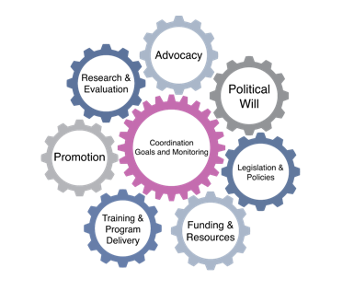
Becoming Breastfeeding Friendly (BBF)
Methods for
Policy Recommendation Development and Prioritization Process
1

Slide 2
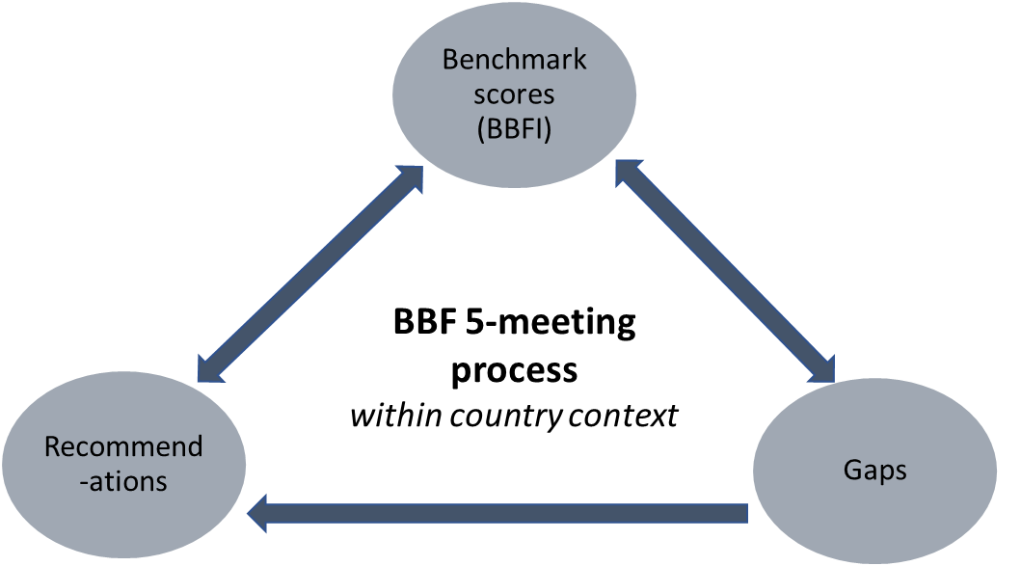
Background
A key product of BBF is generating robust, concrete recommendations to address the gaps identified from the BBFI and 5-meeting process that can be acted upon by key stakeholders
It is important for the translation of recommendations to action that:
Recommendations are meaningful and understood by key stakeholders
Top recommendations are selected and presented clearly to key stakeholders
We provide guidance on developing recommendation and identifying top priority recommendation that can be shared at the 5th meeting
The Child Health and Nutrition Research Initiative (CHNRI) research priority-setting methodology has been adapted for BBF recommendation priority-setting (1)
1. Rudan I, Gibson JL, Ameratunga S, Arifeen SE, Bhutta ZA, Black M, Black RE, Brown KH, Campbell H, Carneiro I, Chan KY. Setting priorities in global child health research investments: guidelines for implementation of CHNRI method. Croatian medical journal. 2008 Dec 15;49(6):720-33.
Notes:
As you know, one of the key products of BBF are the recommendations generated to fill gaps that have been identified or confirmed via the benchmark and gear scores.
The recommendations propose actions that are meaningful and understood by key stakeholders and decision makers, and it is important that top priority recommendations to be clearly developed and highlighted for stakeholders at the 5th meeting.
Therefore, we provide guidance on these important elements of BBF – both the development of recommendations and the identifying of top priority recommendations.

Slide 3
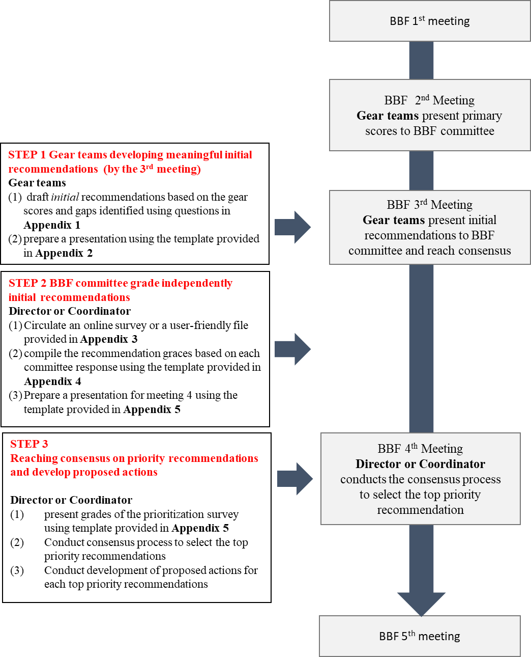
Notes:
Highlights where within the 5-meeting process the steps in recommendation development and prioritization take place.

Slide 4
Step 1: Developing meaningful initial recommendations to be presented at the 3rd meeting
By the 3rd meeting, consensus of final scores should be reached and gear teams should present a full list of their recommendations to the committee.
Appendix 1, listed in the Training slides in PPT form and on its own as a Word document, provides a template that gear teams can use to develop each recommendation for presentation in the 3rd meeting.*
In the 3rd meeting, the committee should discuss all gear team recommendations, and agree on a final list of recommendations.
This list will be the basis for the prioritization survey, so consideration of the criteria that will be accounted for will help the committee
*Appendix 2 is a ppt template for presenting recommendations with Appendix 1 as the basis for the presentation.

Slide 5
Policy Recommendation Development (Appendix 1)
Initial Recommendation
WHAT do we want to happen?
WHY is it important for this recommendation to be achieved?
WHO is going to be responsible for the activity?
WHEN should this recommendation be completed by? (Give a time frame and specific immediate or long-term)
HOW will this recommendation get done?
HAVE similar actions been effective in enabling the breastfeeding environment in other contexts? (Provide examples and use BBF case studies.)
Revisions proposed in meeting 3 discussion

Slide 6
Criteria and Questions for Grading Recommendations
These top 3 criteria were chosen by the BBF TAG members and country representatives from an original list of 8 in a survey. Questions to assess each criteria were developed by the Yale BBF Team.
Criteria | Explanation of criteria
Effectiveness | This criterion assesses the recommendations effectiveness by understanding if this recommended action has an effect or impact on breastfeeding outcomes. This is primarily assessed through understanding the existing evidence regarding the effect or impact of this recommendation elsewhere.
Affordability | This criterion assesses the affordability of recommendations based on an understanding of available information on the cost of implementing such recommendation, and the likely financial means to pay for it.
Feasibility | This criterion assesses the feasibility of the recommendations by understanding whether all the necessary resources to implement such recommendation are present.

Slide 7
Step 2: BBF committee members independently grade recommendations before the 4th meeting
After the 3rd meeting, the director or coordinator will pull all the revised recommendation tables (Appendix 1) that were decided upon by the committee into the prioritization survey (Appendix 3 – online version of Word version) and send the survey to the committee.
With all of the committee member responses, the director or coordinator will use Appendix 4a or Appendix 4b to generate summary grades for each recommendation (see slide 9-11 for options for this process).
By the 4th meeting, the director or coordinator will prepare a presentation (Appendix 5 is a template) to share the recommendation grades with the committee at the 4th meeting
*Note there are many steps to do between the 3rd and 4th meeting, which requires strong coordination and time management from the director.

Slide 8
Questions asked for each recommendation in Appendix 3: Recommendation Grading Survey
Criteria | Questions with response options: Yes, No, Cannot Decide, or No Answer
Effectiveness | Is there high-quality evidence and knowledge of this recommendation being effective (i.e. having an impact) from other contexts? Is the evidence for this recommendation translatable to your context? Is this recommendation scalable?
Affordability | Is the cost of implementing this recommendation known? Can this recommendation be funded? Are there potential funders who can fund this recommendation?
Feasibility | Are the necessary human and financial resources in place (or can reasonably be expected to be in place) to implement this recommendation? Are the necessary institutions and partnerships in place (or can reasonably be expected to be in place) for this recommendation to be implemented? Is there a foreseeable path to fully and successfully implement this recommendation?

Slide 9
Survey Option 1: Google Forms & Excel
This option would be appropriate if the committee members are comfortable filling out an online survey, and you are comfortable managing Google Forms (no need to have prior experience; it is fairly straightforward)
Please see Appendix 4: Recommendation Grade Calculators for instructions or Appendix 4b: Summary Grade Calculators for instructions on how to complete the online survey.
Input recommendation tables (i.e. finalized version of Appendix 1) for each recommendation into the Google Forms starting at section 4 of the Google Forms survey.
Each subsequent section will be a different recommendation.
If you have more than 10 recommendations from the committee, you will need to add sections to the survey.
Send Survey to committee members
Suggestion: set a deadlines for completion and follow-up on the deadline
Responses will be transferred to Google Sheets when you select the “responses” tab
Copy responses into the “Form Responses” sheet of the Excel file “Appendix 4: ‘Becoming Breastfeeding Friendly’ (BBF) Policy Recommendation Development Grading Survey Responses”
Recommendation Grades will be autogenerated and summarized on the sheet “Summary”
Use this output to develop your presentation for the 4th meeting

Slide 10
Survey Option 2: Word Document & Excel
This option would be appropriate if the committee members would prefer to work in word documents and/or on print paper. You would need to be comfortable with basic data entry into Excel.
Please see Appendix 4: Recommendation Grade Calculators for instructions or Appendix 4b: Summary Grade Calculators for instructions on how to complete the survey using Word or in person.
Input recommendation tables (i.e. finalized version of Appendix 1) for each recommendation into the Word Document survey starting at section 4.
Each subsequent section will be a different recommendation.
If you have more than 10 recommendations from the committee, you will need to add sections to the survey.
Send Survey to committee members
This could be by email or in-person depending on what is best for your committee members
Suggestion: set a deadlines for completion and follow-up on the deadline
Collect all paper and/or electronic surveys and enter the responses into the Excel file sheet “Form Responses”
Excel file name: “Appendix 4: ‘Becoming Breastfeeding Friendly’ (BBF) Policy Recommendation Development Grading Survey Responses”
Recommendation Grades will be autogenerated and summarized on the sheet “Summary”
Use this output to develop your presentation for the 4th meeting

Slide 11
Step 3: Reaching consensus on priority recommendations and develop proposed actions
At the 4th meeting, the director or coordinator will present the summary grades for all recommendations (Appendix 5 is a template)
This presentation should facilitate a discussion among the committee regarding top recommendations
The outcome should be consensus on 3-5 top priority recommendations
Once the committee has agreed on the top priority recommendations, the director or coordinator should facilitate the development of proposed actions for each recommendation
Proposed actions should be driven by consensus across the committee

Slide 12
Example

Slide 13
Example – Step 1: Developing meaningful initial recommendations to be presented at the 3rd meeting
Notes:
Our example is from Legislation and Policies gear team and it is related with the adoption of the Code. For this hypothetical country, we are assuming they have scored minimal progress for LPG4 and LPG5. So, one of the gaps identified by this gear team was related to the implementation of the Code.
Based on their benchmark scores, between meeting 2 and 3, following the template provided (this template correspond to Appendix 1), gear team developed the initial recommendation. The Gear team discussed and write down a meaningful recommendation following the questions WHAT, WHY, WHEN, HOW – thinking about their country context and how they were envisioning the implementation of this recommendation. The HAVE question [read the slide] was answered using the Evidence Based Brief with the case-study from Vietnam that has similar barriers and gaps.
Evidence Based Briefs are small case study that provide real world examples. They are not meant to be a systematic review but rather bring ideas on how recommendations can be translated into actions. They will be delivery together with the prioritization process and they are organized by gear.
That said, the initial recommendation developed was [read slide for all the questions]. This recommendation was presented by the gear team at the third meeting for all committee members.

Slide 14
Example – Step 1: Developing meaningful initial recommendations to be presented at the 3rd meeting
Notes:
During the meeting 3, based on discussion with the committee members, there was a suggestion to combine this initial recommendation from Legislation Gear team with one from Research and Evaluation gear team. Since both gear teams have provided similar recommendation. Country coordinator should take notes as you can see in red in this example.

Slide 15
Example – Step 2: BBF committee members independently grade recommendations before the 4th meeting
In the survey, each recommendation is presented and 9 questions are answered for each recommendation, as follows:
Notes:
After compiling all recommendations, country coordinator or director will prepare and send a survey using the templates in Appendix 1 and 3 (you can see Appendix 1 on the left side of slide and Appendix 3 at right side). The survey will be sent to Committee members to grade each recommendation using 9 ended-closed questions related to effectiveness, affordability and feasibility. These questions have 4 options that will be graded.

Slide 16
Example – Step 3: Reaching consensus on priority recommendations and develop proposed actions
Notes:
After committee members completing the survey, starts step 3. Previous to meeting 4, the coordinator or Director will compile the responses of committee members using an excel file template that has embed an algorithm to calculate recommendations grades.
At meeting 4, coordinator or Director will present to committee members, the final grades of each recommendations. As you can see on the top of the slide, individual grade and recommendation grade should be presented.
At this point it is expected that committee members reach consensus top priority recommendations. These can be done based on final grade for each recommendation but also considering committee members’ discussion and consensus.
For each of those top priority recommendations, using the template provided (as you can see at the bottom of the slide) committee members should develop proposed actions to move forward with implementing this recommendation. This proposed actions will guide the dissemination and advocacy process of translating recommendations into action AND it also can be used to monitor progress over years.
Once the BBF committee has developed proposed actions for top priority recommendations. Committee members can plan and discuss on how this will be disseminated at meeting 5.

Slide 17
Appendices
Appendix 1. Recommendations Development Template
Appendix 2. PowerPoint Template for Initial Recommendations Presented in the 3rd Meeting by Gear Teams (see all 8)
Appendix 3. Survey Template (See Google Forms for online version and Word Document for in-person version)
Appendix 3a. Country Director-Coordinator Email to Committee Members
Appendix 4. Recommendation Grade Calculators (See Google Sheets and Excel document)
Appendix 4a. Survey Management Options Instructions
Appendix 4b. Summary Grade Calculators
Appendix 5. Template for priority recommendation and development of key actions (See PowerPoint File)
Appendix 6. Methods and Guidelines for Policy Recommendation Development & Prioritization Process (PPT and Word document)

