Slide 1
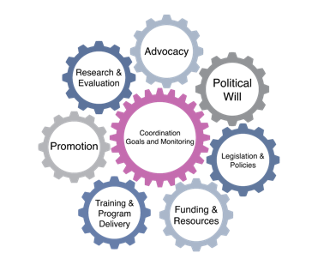
Becoming Breastfeeding Friendly (BBF)
Brief Development Guidance
Part III. Policy Brief
1
Notes:
Now, we are going to move on and discuss how to write a policy brief for use with BBF

Slide 2
Objectives
Delineate policy brief aims
Describe steps to policy brief writing
Illustrate examples of policy brief writing exercises
Notes:
[CLICK] First, we will delineate policy brief aims
[CLICK] Next, we will describe steps to writing a successful policy brief
[CLICK] Finally, we will illustrate a couple of examples of policy brief writing exercises

Slide 3
Key Aspects of Different Briefs
Type of brief | Length | Aim | Potential audience | When to prepare? | When to use?
Policy 1-pager | up to 2 pages | Engage stakeholders | Stakeholders | Between 1st and 2nd meeting | Throughout the 5-meeting process and beyond
Infograph | 1 page | Disseminate policy recommendations and summarize all policy evidence | Stakeholders; general public | Between 4th and 5th meetings | By 5th meeting and beyond
Policy brief | up to 4 pages | Disseminate prioritized recommendations | Policymakers, journalists, senior advisers to policymakers | Between 4th and 5th meetings | By 5th meeting and beyond
Adapted from: Wong SL, Green LA, Bazemore AW, Miller BF. How to write a health policy brief. Families, Systems, & Health. 2017 Mar;35(1):21. 7
Notes:
As discussed, there are many different types of briefs that communicate policy ideas
A policy brief of up to 4 pages [CLICK] can be used to disseminate prioritized recommendations to a potential audience of policymakers and journalists
These should be prepared between the 4th and 5th meetings to be presented to policymakers and other decision makers by the 5th meeting as well as after
They should each focus on one prioritized recommendation developed throughout the 5-meeting process, although each BBF country’s needs and capacity should determine how many policy briefs – again, each one focusing on one prioritized recommendation – to develop and disseminate
This means that, if a country lacks the capacity the develop one or more policy briefs based on BBF prioritized recommendations, then the country can adopt other, less labor-intensive means of communicating policy ideas to policymakers and other decision makers; remember that the BBF team at Yale is available for assistance as needed

Slide 4
1-pager
Infograph
+ Policy Brief
Dissemination strategies
1st
Meeting
2nd
Meeting
3rd
Meeting
4th
Meeting
5th
Meeting
Suggested BBF brief development timeline
Notes:
Here, I again present the same timeline you saw in the “Background” section of this training of recommended activities to complete during the BBF 5-meeting process
In terms of when throughout the BBF 5-meeting process the different forms of briefs should be developed and disseminated, they should each focus on one prioritized recommendation developed throughout the 5-meeting process
They can be prepared throughout the 5-meeting process to be presented to policymakers and other decision makers between the 4th and 5th meeting as well as at, or during, the 5th meeting and beyond [CLICK]

Slide 5
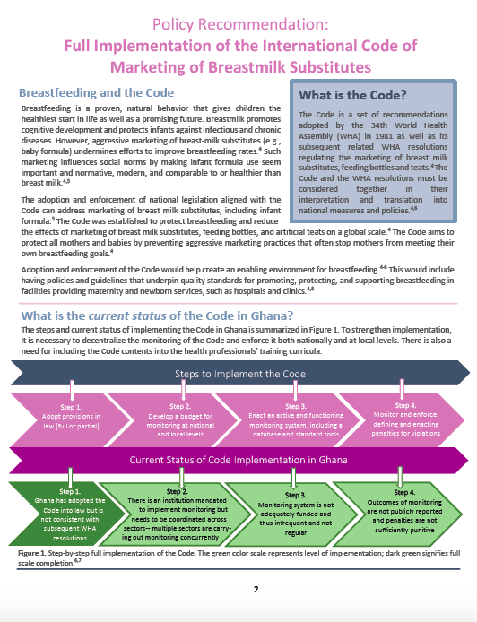
Policy Brief Development Background
Notes:
[CLICK] The BBF Team decided to put on this training for the purpose of being used during policy dialogues, a tool, or dissemination strategy, used to guide policy development and improve contextualization and utilization of evidence in policymaking
Policy dialogues are usually informed by policy briefs

Slide 6
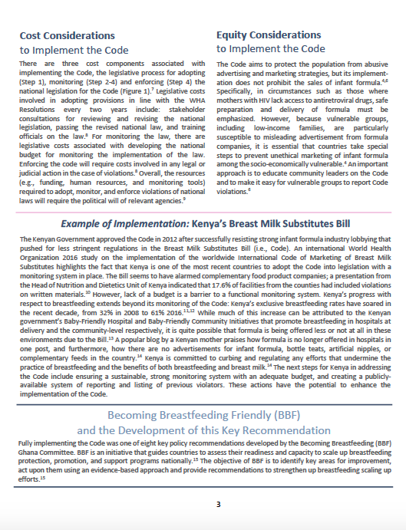
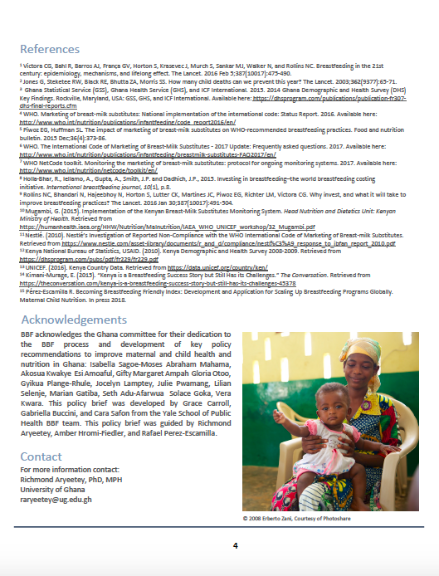
What is a Policy Brief?
Notes:
[CLICK] Policy briefs are intended to package evidence in a way that is accessible, relevant, easy to use, and applicable
They start with the priority policy issue and often feature issues related to governance, financing and delivery, and implementation
The example you see here is the BBF policy brief on the full implementation of the International Code of Marketing of Breastmilk Substitutes in Ghana
Of course, policy briefs can be developed for a variety of purposes in the context of BBF, a concept that I will describe on the following slides
(For additional examples, please see BBF website)

Slide 7
What is a Policy Brief?
Policy briefs should prompt change in law, regulations, or program implementation
They should include short, easy-to-understand sentences using active voice and avoiding jargon
They should address an audience of policymakers and/or decision makers, and using, simple language:
Explain the aim, purpose, or message that is meant to be conveyed
Discuss the problem to be addressed
Suggest policy changes or recommended actions
Include a ‘Call to Action’
Include a title explaining what the policy brief is about
Adapted from: Johns Hopkins Bloomberg School of Public Health. The Women’s and Children’s Health Policy Center. Writing Policy Briefs: A guide to Translating Science and Engaging Stakeholders. 2012. Available at: https://www.jhsph.edu/research/centers-and institutes/womens-and-childrens-health-policy-center/de/policy_brief/index.html
Adapted from: Wong SL, Green LA, Bazemore AW, Miller BF. How to write a health policy brief. Families, Systems, & Health. 2017 Mar;35(1):21. 7
Notes:
Now, it is important to consider the following when developing your 4-page policy brief
[CLICK + READ BULLET 1]
[CLICK + READ BULLET 1]
[CLICK + READ BULLET 1]
[CLICK]
[CLICK]
[CLICK]
[CLICK]
[CLICK]

Slide 8
Steps to Policy Brief Writing
2. State gaps identified and supported by BBFI
4. Make your case, using proposed actions
3. State priority recommen-dations using proposed actions
5. Discuss the impact
1. Outline your policy brief
Adapted from: Wong SL, Green LA, Bazemore AW, Miller BF. How to write a health policy brief. Families, Systems, & Health. 2017 Mar;35(1):21. 7
Notes:
Adapted from Wong and colleagues, these are the 5 steps involved in writing a policy brief; we have adapted these and tailored them to the BBF context. They are:
1. Outline your policy brief
2. State gaps identified and supported by BBFI
3. State priority recommendations using proposed actions
4. Make your case, using proposed actions
5. Discuss the Impact

Slide 9
Steps to Policy Brief Writing
2. State gaps identified and supported by BBFI
4. Make your case, using proposed actions
3. State priority recommen-dations using proposed actions
5. Discuss the Impact
1. Outline your policy brief
Adapted from: Wong SL, Green LA, Bazemore AW, Miller BF. How to write a health policy brief. Families, Systems, & Health. 2017 Mar;35(1):21. 7
Notes:
First, we recommend outlining your policy brief

Slide 10
Steps to Policy Brief Writing
Step 1: Draft an outline of your policy brief before you develop content and consider style
Notes:
We recommend outlining your policy brief before thinking about how you want to organize the content in order to lay the foundation for the content you want to include; this will help ensure that 1) you are including only the most important information, and 2) that you are not forgetting any vital data

Slide 11
Exercise A: Beginning Your Policy Brief
Use these questions to begin thinking about your policy brief’s purpose, audience, and contribution.
What problem will your brief address?
Who is the audience?
Why is the problem important to them?
What do you know about the audience (e.g., technical knowledge, political or organizational culture or constraints, exposure to the issue, potential openness to the message)?
What other policy or issue briefs already exist? How will your brief differ (e.g., different information, perspective, aim, or audience)?
Johns Hopkins Bloomberg School of Public Health. The Women’s and Children’s Health Policy Center. Writing Policy Briefs: A guide to Translating Science and Engaging Stakeholders. 2012. Available at: https://www.jhsph.edu/research/centers-and institutes/womens-and-childrens-health-policy-center/de/policy_brief/index.html
Notes:
Now, when beginning to write your policy brief, it might be helpful to also ask yourself the following questions [taken directly from the JHSPH resource]
[CLICK + READ italicized sentence]
[CLICK Q1]
[CLICK Q2]
[CLICK Q2A]
[CLICK Q2B]
[CLICK Q3]

Slide 12
Exercise B: Outlining Policy Brief Content
Use these questions to lay out the framework and basic content of your policy brief.
What is the aim of the policy brief? Write one or two sentences from which the rest of the brief will follow.
What is the best hook for the audience?
What background information does the audience need?
What data are most important to include for your audience? How will you present the data so it best conveys its message (e.g., in text, bar graph, line graph)?
What are the policy options (if appropriate to your topic/aim)?
What recommendations will you make?
Johns Hopkins Bloomberg School of Public Health. The Women’s and Children’s Health Policy Center. Writing Policy Briefs: A guide to Translating Science and Engaging Stakeholders. 2012. Available at: https://www.jhsph.edu/research/centers-and institutes/womens-and-childrens-health-policy-center/de/policy_brief/index.html
Notes:
You might also consider these questions [taken directly from the JHSPH resource]
[CLICK + READ italicized sentence]
[CLICK Q1]
[CLICK Q2]
[CLICK Q3]
[CLICK Q4]
[CLICK Q5]
[CLICK Q6]

Slide 13
Steps to Policy Brief Writing
2. State gaps identified and supported by BBFI
4. Make your case, using proposed actions
3. State priority recommen-dations using proposed actions
5. Discuss the impact
1. Outline your policy brief
Adapted from: Wong SL, Green LA, Bazemore AW, Miller BF. How to write a health policy brief. Families, Systems, & Health. 2017 Mar;35(1):21. 7
Notes:
Now that you have outlined your policy brief, we then recommend stating gaps identified and supported by the BBFI

Slide 14
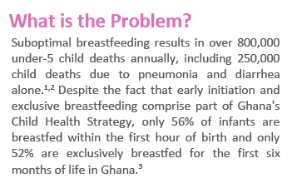
Steps to Policy Brief Writing
Step 2: State gaps
What are the gaps?
Why are they important?
Why now?
Who cares?
Adapted from: Wong SL, Green LA, Bazemore AW, Miller BF. How to write a health policy brief. Families, Systems, & Health. 2017 Mar;35(1):21. 7
Notes:
[CLICK] Step 2: Defining the problem involves asking several important questions, including:
[CLICK] 1) What are the gaps
[CLICK] 2) Why are they important
[CLICK] 3) Why now, and
[CLICK] 4) Who cares
[CLICK] For example, a gap outlined in an existing BBF policy brief is that of suboptimal breastfeeding practices/outcomes, a problem that many priority recommendations could help solve

Slide 15
Steps to Policy Brief Writing
2. State gaps identified and supported by BBFI
4. Make your case, using proposed actions
3. State priority recommen-dations using proposed actions
5. Discuss the impact
1. Outline your policy brief
Adapted from: Wong SL, Green LA, Bazemore AW, Miller BF. How to write a health policy brief. Families, Systems, & Health. 2017 Mar;35(1):21. 7
Notes:
Third, we recommend stating the prioritized recommendation using proposed actions

Slide 16
Steps to Policy Brief Writing
Step 3: State the priority recommendations
Identify 1-3 specific proposed actions to address the problem you identified
Adapted from: Wong SL, Green LA, Bazemore AW, Miller BF. How to write a health policy brief. Families, Systems, & Health. 2017 Mar;35(1):21. 7
Notes:
[CLICK] Step 3: State the policy involves:
[CLICK]: Identifying 1-3 specific proposed actions to address the problem
[CLICK] For example: the International Code of Marketing of Breastmilk Substitutes - or the Code – is an example of a policy intended to protect children and mothers from harmful marketing practices that encourage mothers to purchase and offer breastmilk substitutes, like infant formula, to their babies and young children; a proposed action could be strengthening the Code
Identifying specific ways to strengthen the Code would enhance the policy brief

Slide 17
Reaching consensus on priority recommendations and develop proposed actions
For each top priority recommendation, develop proposed actions as a committee with consensus.
Priority Recommendation | Proposed Actions
Strengthen enforcement of Code of Marketing of Breast Milk Substitutes within 5 years. | Develop a budget line for monitoring and enforcement of the national law Develop a monitoring system at national and local levels Develop a penalties system in accordance with severity Develop and define multi-sectoral enforcement strategies Educate health professionals about the law and code violations
Notes:
To elaborate on developing proposed actions - early steps on reaching consensus on priority recommendations and developing proposed actions involve summarizing each prioritized recommendation’s BBF scores in terms of effectiveness, affordability, and feasibility; this can be done based on final grade for each recommendation but also considering committee members’ discussion and consensus
Now, for each of these priority recommendations, using the template you see here, you can develop proposed actions to move forward with implementing this recommendation
This proposed actions will guide the dissemination and advocacy process of translating recommendations into action AND it also can be used to monitor progress over years

Slide 18
Steps to Policy Brief Writing
2. State gaps identified and supported by BBFI
4. Make your case, using proposed actions
3. State priority recommen-dations using proposed actions
5. Discuss the impact
1. Outline your policy brief
Adapted from: Wong SL, Green LA, Bazemore AW, Miller BF. How to write a health policy brief. Families, Systems, & Health. 2017 Mar;35(1):21. 7
Notes:
Step 4, Making your case involves showing why the recommended action on which you are basing your policy brief is valuable, drawing on evidence to support your claim or claims and using the proposed actions identified in Step 3

Slide 19
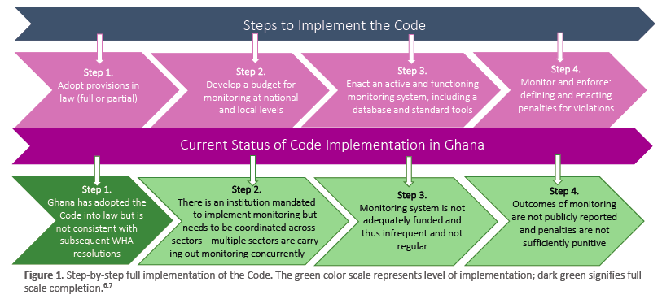
Steps to Policy Brief Writing
Step 4: Make your case
Display or describe relevant data
Refer to other related data sources
Adapted from: Wong SL, Green LA, Bazemore AW, Miller BF. How to write a health policy brief. Families, Systems, & Health. 2017 Mar;35(1):21. 7
Notes:
[CLICK] Step 4: Making your case involves:
[CLICK] displaying or describing relevant data
[CLICK] referring to other related data sources
[CLICK] For example, here is a graphic showing how gaps between the current status of Code implementation and the required steps to Code implementation can be filled in a given country

Slide 20
Steps to Policy Brief Writing
2. State gaps identified and supported by BBFI
4. Make your case, using proposed actions
3. State priority recommen-dations using proposed actions
5. Discuss the impact
1. Outline your policy brief
Adapted from: Wong SL, Green LA, Bazemore AW, Miller BF. How to write a health policy brief. Families, Systems, & Health. 2017 Mar;35(1):21. 7
Notes:
Fifth, Step 5: Discussing the impact involves demonstrating how the prioritized recommendation highlighted in the policy brief affects populations of interest, as well as any stakeholders who may be affected by them

Slide 21
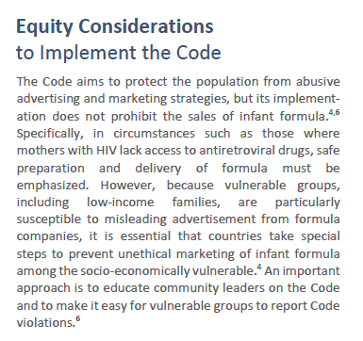
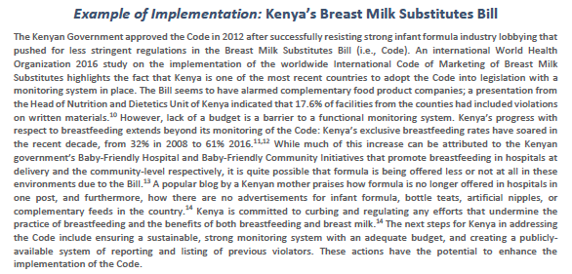
Steps to Policy Brief Writing
Step 5: Discuss the impact
Discuss implications of both action and inaction
Consider intended and unintended consequences
Adapted from: Wong SL, Green LA, Bazemore AW, Miller BF. How to write a health policy brief. Families, Systems, & Health. 2017 Mar;35(1):21. 7
Notes:
[CLICK] Step 5: Discussing the impact involves:
[CLICK] Discussing the implications of action + inaction
[CLICK] Considering both intended + unintended consequences
[CLICK] For example, you might consider equity, costs, and other important ideas when adopting policy recommendations
[CLICK 2X] We would also like to highlight the inclusion of an example of implementation, which illustrates an evidence-based example of a country in which the recommended action has been implemented; for example, for the Code, we offer an example of Kenya's Breast Milk Substitutes Bill

Slide 22
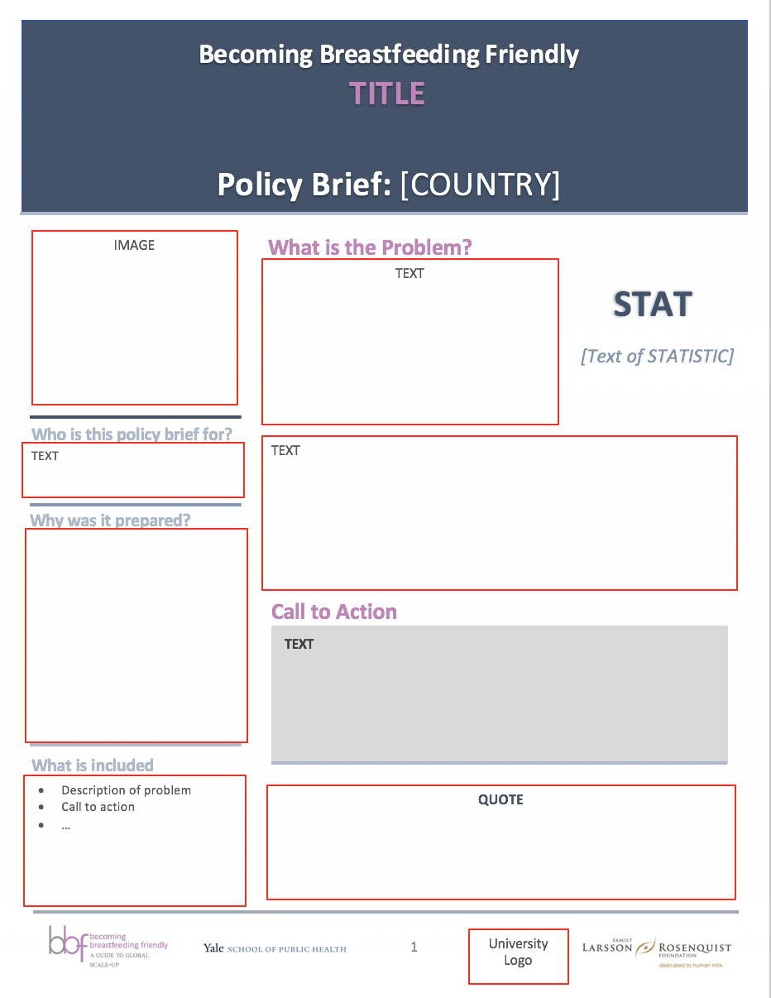
Policy Brief Example & Template
Notes:
We have provided an example of a policy brief and template that can be used, should your country be able to develop one or more
The next section of this training series will focus on branding and design of your BBF briefs

