Slide 1
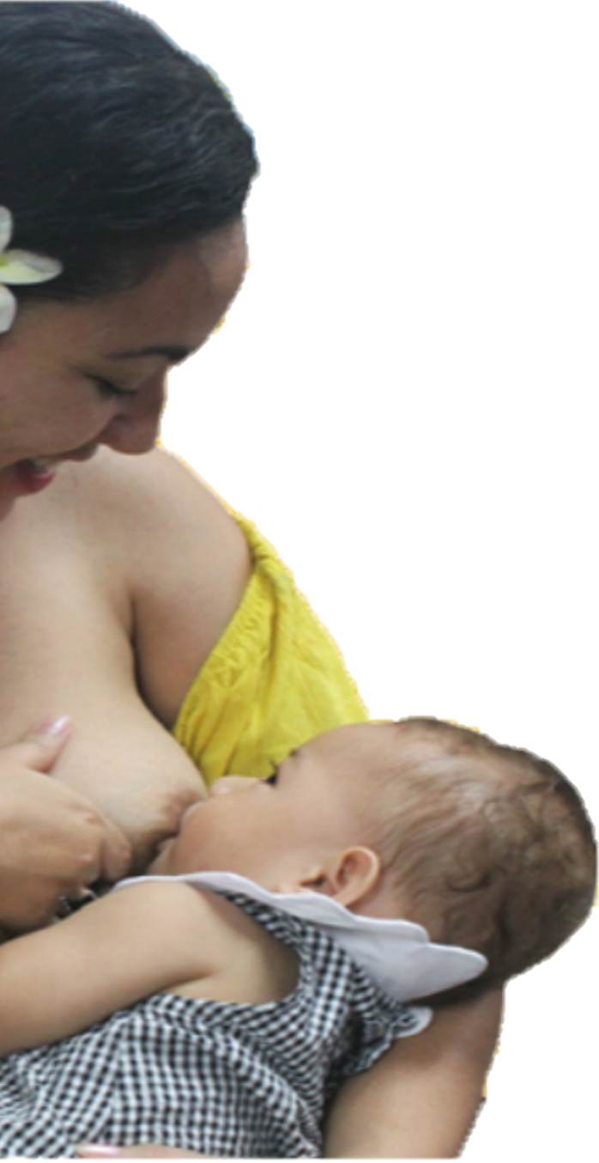
Becoming Breastfeeding Friendly
Policy Brief: Samoa
What is the Problem?
7 in 10
Breastfeeding is the foundation of lifelong good health and well-being for infants and mothers, and is critical to achieving the Sustainable Development Goals.¹⁻³ The United Nations Children’s Fund and World Health Organization recommends 6 months of exclusively breastfeeding, as it provides adequate nutrition for optimal growth and development.⁴ Despite the fact that 81% of infants are breastfed within the first hour of birth, only 70% are exclusively breastfed for six months in Samoa.⁵
Samoan infants are exclusively breastfed for the first six months of life⁵
While breastfeeding is a natural act, it is also a learned behavior. An extensive body of research has demonstrated that mothers and other caregivers require active support for establishing and sustaining appropriate breastfeeding practices.⁵⁻⁷ Multisectoral efforts are needed to protect, promote and support breastfeeding; ⁷⁻⁸ however, it is critical to reflect on current efforts, identify gaps in programming, and present evidence-based recommended actions to move forward in an effective and sustainable manner to improve breastfeeding rates.
Who is this policy brief for?
Government policymakers, decision makers, stakeholders and their support staff.
Becoming Breastfeeding Friendly (BBF) Process
1
Learn about BBF
2
Preliminary Scoring of Gears
3
Call to Action
5
Finalize Scoring
Recommend Actions
4
The BBF process guides countries with assessing the current national breastfeeding efforts and their readiness to scale up their breastfeeding protection, promotion, and support programs. This evidence-based process was first developed by Dr. Rafael Perez-Escamilla at Yale School of Public Health and an expert group, and uses a Breastfeeding Gear Model to score country’s breastfeeding performance ‘gears’ which must be at work and in harmony for large-scale improvement in country’s national breastfeeding program. The model includes 54 evidence-based benchmarks within eight gears: 1) Advocacy, 2) Political Will, 3) Legislation & Policies, 4) Funding & Resources, 5) Training & Program Delivery, 6) Promotion, 7) Research & Evaluation, and 8) Coordination, Goals & Monitoring.
Why was it prepared?
To share the key policy recommendations developed by the Becoming Breastfeeding Friendly initiative in Samoa, which identified gaps in national breast-feeding programs.
What is included?
Description of problem
Becoming Breastfeeding Friendly Process
Development of the Priority Recommendations
Priority Recommendations and Call to Action
“Quote”
1

Slide 2
Development of the Priority Recommendations
In consultation with the Samoa Ministry of Health, a 8-member BBF committee with membership from the National Health Services, Ministry of Education Sports and Culture, Public Service Commission, Samoa Red Cross, Samoa Family Health Association, National University of Samoa, Ministry of Commerce Industry and Labour, Ministry of Women, Community and Social Development was established to implement the process. The committee held four meetings between January and July 2018. Using a rigorous scoring process, the BBF committee scored the national BBF performance, by consensus, on the 8 gears using best available evidence.
Advocacy
1.5
Research & Evaluation
1.8
Political
Will
2.0
Coordination, Goals & Monitoring
1.7
Promotion
2.0
Legislation & Policies
1.8
SCORE LEGEND
Gear Total Score | Interpretation
0 | Gear not present
0.1 to 1.0 | Weak Gear Strength
1.1 to 2.0 | Moderate Gear Strength
2.1 to 3.0 | Strong Gear Strength
Training & Program Delivery
1.8
Funding & Resources
0.5
Priority Recommendations and Call to Action
1. Develop and Implement a National Breastfeeding Policy and Strategic Action Plan
Proposed Actions:
Draft and submit a proposal for a National Breastfeeding Policy that is all inclusive of a strategic action plan, and performance indicators. Needs to include: 1) Integration of breastfeeding into other Health Events during the year, 2) Infant and Young Child Feeding Regulations and set plan annual for biennium for activities to be in place , 3) Annual National Symposium for Breast feeding, 4) Development of support network and service for breastfeeding free text messaging hotline, 5) Acknowledgement of champion(s), 6) Be inclusive of all people in Samoa, including potentially vulnerable groups (examples: disabled, abused, refugees, and people living with HIV)
Conduct consultations of the proposed policy, strategic action plan, and performance indicators
2. Strengthen capacity to monitor and evaluate all breastfeeding activities
Proposed Actions:
Publish Breastfeeding Practices Data online via website such as the Ministry of Health
Establish population-based surveillance or monitoring system to track the breastfeeding, lactation counseling and support, every 5 years
Strengthen implementation of quarterly and annually routine data collection of breastfeeding during clinical and community outreach visits
2

Slide 3
Priority Recommendations and Call to Action
3. Ratify International Labour Organization Maternity Protection Convention 2000
Proposed Actions:
Discuss and approve the Convention provisions : 1) Maternity protection against work that presents risks to the mother or child’s health, 2) Maternity leave is more than 14 weeks (6 weeks compulsory leave after childbirth), 3) Prenatal period of leave is extended between the presumed date of birth and actual date without reducing compulsory portion of prenatal leave, 4) cash benefits, employment protection, and 5) breastfeeding breaks
Establish formal mechanism for maternity entitlement for all working women
4. Have champions on Breastfeeding to become role models to advocate for breastfeeding
Proposed Actions:
Identify local and global champions
Develop activities and training for champions to be involved with Breastfeeding.
Share success stories from the community via different media (For example, TV, documentary, and/or Facebook)
5. Create a national budget line for breastfeeding activities
Proposed Actions:
Develop a proposal for national budget line in alignment with the (future) National Breastfeeding policy and strategic action plan
Identify the cost of key activities for breastfeeding advocacy, promotion, education, and training every fiscal year
Include in the budget line: 1) The National Breastfeeding Program, 2) The Baby Friendly Hospital Initiative/ Ten Steps, 3) The International Code of Marketing of Breast Milk Substitutes monitoring and enforcement, 4) Maternity Protection, 5) Breastfeeding related information, Education and Communication campaigns and materials, and 6) Breastfeeding training and program delivery
6. Seek and hire a national counsellor and trainer position for breastfeeding
Proposed Actions:
Develop selection criteria or job description for national counsellor and trainer
Recruitment and selection of national counsellor and trainer
Train the trainer to fulfill the following core functions: implement BFHI, in-service training for staff in maternity service, conduct individual counseling for lactation issues, certify BF counseling training program by Samoa Qualification Authority (SQA), coordinate professional development for breastfeeding, advocate for ccurriculum to include breastfeeding and be uniform for all pre-service education, nursing, and medicine
3

Slide 4
Annex: Full List of Recommendations
Integrate Breastfeeding into other Health Events during the year, strategies, and policies
Seek a champion on Breastfeeding to become a role model to advocate for Breastfeeding.
Develop an evidence-based National Breastfeeding Advocacy Strategy
Strengthen commitment to breastfeeding action at the political level
Improve Government’s efforts towards promoting an enabling environment for breastfeeding at a National level
Government to be more proactive in creating awareness of legislations and policies affecting female employees
Ratify Maternity Protection Convention 2000
Legislation for Supporting Worksite for Breastfeeding Women
To have a National Breastfeeding Policy
Formal mechanism for maternity entitlement for all working women
Endorse Infant and Young Child Feeding Regulations.
Review outdated National Infant and Young Child feeding Strategy and incorporate Promotion Strategy for Breastfeeding
Publish Breastfeeding Practices Data online via MOH website
Need to establish an annual population-based surveillance or monitoring system to track the breastfeeding, lactation counseling and support
Strengthen implementation of routine data collection of breastfeeding during clinical visits (CHNIS)
To create a national budget line for Breastfeeding Promotion Activities.
National IYCF has a set plan annual for biennium for activities to be in place.
To have a national Coordinator position for Breastfeeding for Lactation Counselor/ Master Trainer and BFHI/Ten Steps
Certification BF counseling training program by Samoa Qualification Attorney (SQA)—MOH and SQA need to certify the Breastfeeding counseling program
Curriculum should include breastfeeding and be uniform for all pre-service education, nursing, and medicine
To have an annual breastfeeding training and regular in-service training for new staff in the maternity services
Conduct Annual National Symposium for Breast feeding
Create Support network and service for breastfeeding free SMS helpline.
References
¹ Horta BL, Bahl R, Martinés JC, Victora CG, World Health Organization. Evidence on the long-term effects of breastfeeding: systematic review and meta-analyses.
² Arenz S, Rückerl R, Koletzko B, von Kries R. Breast-feeding and childhood obesity—a systematic review. International journal of obesity. 2004 Oct;28(10):1247.
³ Victora CG, Bahl R, Barros AJ, França GV, Horton S, Krasevec J, Murch S, Sankar MJ, Walker N, Rollins NC. Breastfeeding in the 21st century: epidemiology, mechanisms, and lifelong effect. The Lancet. 2016 Feb 5;387(10017):475-90.
⁴ World Health Organization. Global strategy for infant and young child feeding. 2003.
⁵ Samoa Bureau of Statistics. Samoa Demographic Health Survey. 2014.
⁶Sikorski J, Renfrew MJ, Pindoria S, Wade A. Support for breastfeeding mothers: a systematic review. Paediatric and perinatal epidemiology. 2003 Oct;17(4):407-17.
⁷Rollins NC, Bhandari N, Hajeebhoy N, Horton S, Lutter CK, Martines JC, Piwoz EG, Richter LM, Victora CG. Why invest, and what it will take to improve breastfeeding practices?. The Lancet. 2016 Jan 30;387(10017):491-504.
⁸ Haddad LJ, Hawkes C, Achadi E, Ahuja A, Ag Bendech M, Bhatia K, Bhutta Z, Blossner M, Borghi E, Eriksen K, Fanzo J. Global Nutrition Report 2015: Actions and accountability to advance nutrition and sustainable development. Intl Food Policy Res Inst; 2015 Sep 15.
⁹ Pérez-Escamilla R, Hromi-Fiedler AJ, Gubert MB, Doucet K, Meyers S, Dos Santos Buccini G. Becoming Breastfeeding Friendly Index: Development and application for scaling-up breastfeeding programmes globally. Matern Child Nutr. 2018 Jul;14(3):e12596.
…
Acknowledgements
Contact
Many thanks to the BBF committee with membership from the National Health Services, Ministry of Education Sports and Culture, Public Service Commission, Samoa Red Cross, Samoa Family Health Association, National University of Samoa, Ministry of Commerce Industry and Labour, Ministry of Women, Community and Social Development and Ministry of Health.
Christina Soti-Ulberg
Principal Nutritionist
Health Protection Enforcement Division
Email: ChristinaU@health.gov.ws
Phone: 68137/68138
4
4

